Slide 1
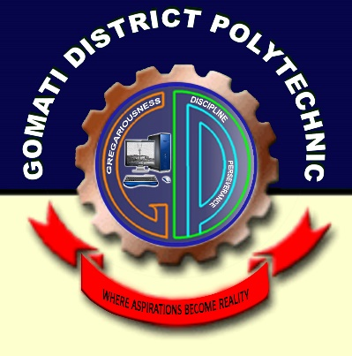
GOMATI DISTRICT POLYTECHNIC
Presentation on Online Job Portal:
PRESENTED BY:
Arkajyoti Roy (216305131)
Argha Chakraborty (216305130)
Aradihto Choudhury (216305129)
Shyamal Paul (216305158)
Shirsendu Das (216305157)
(26305156)

Slide 2
Contants:
Introduction.
Why online job portal are important now a days?
The future of Online Job Portal.
Algorithm.
Flowchart.
Applying for job online.
Security.
Searching for job opportunities.
Performance.
Advantages for job seekers.
Technology used.
References.
Conclusion.

Slide 3
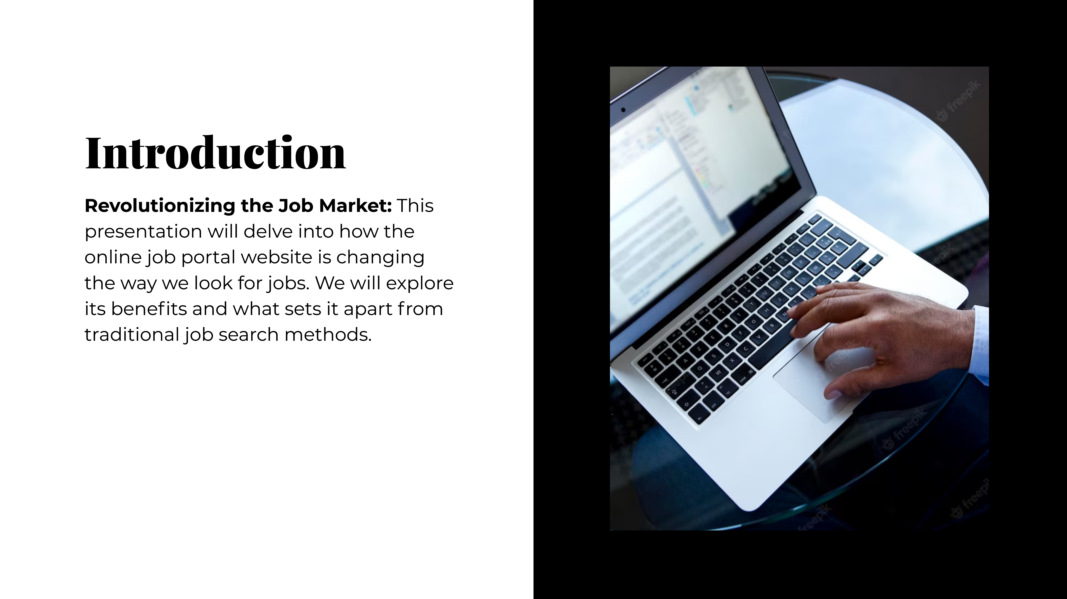
Introduction:
An online job portal is a digital platform that connects job seekers and employers, providing a convenient and efficient way for both parties to find and fill job vacancies. These portals have become increasingly popular due to their ease of use, extensive reach, and ability to streamline the job search process.

Slide 4

Why online job portal are important now a days?
1. Online job application process is time saving. 2. You get relevant jobs that match your qualification. 3. You get fast reply. 4. The database is not restricted to any particular. industry or region. 5. Jobs are well sorted as per different parameters for accurate match. 6. This process is free of cost.

Slide 5
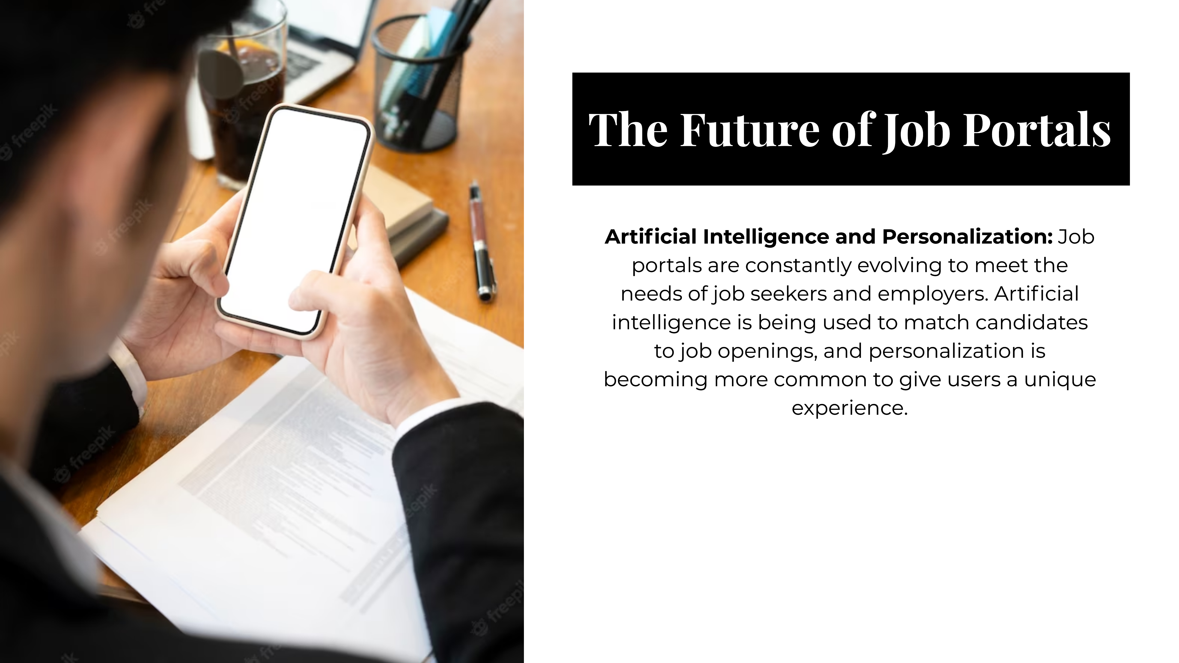
The future of Online Job Portal:

Slide 6
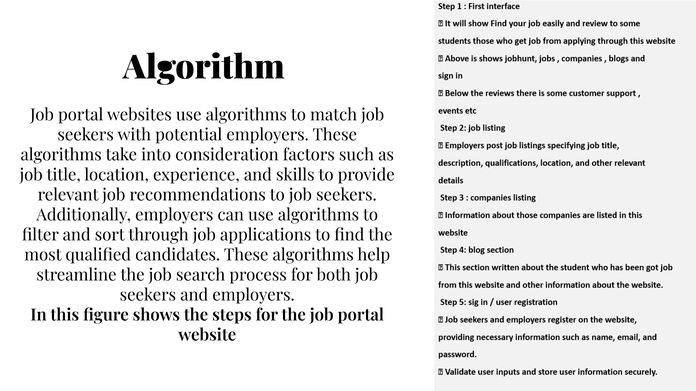

Slide 7
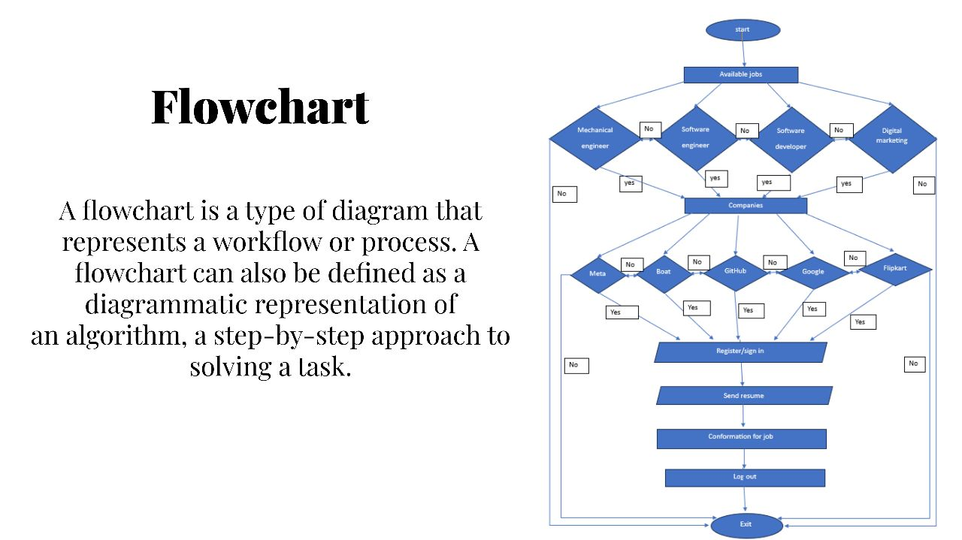

Slide 8
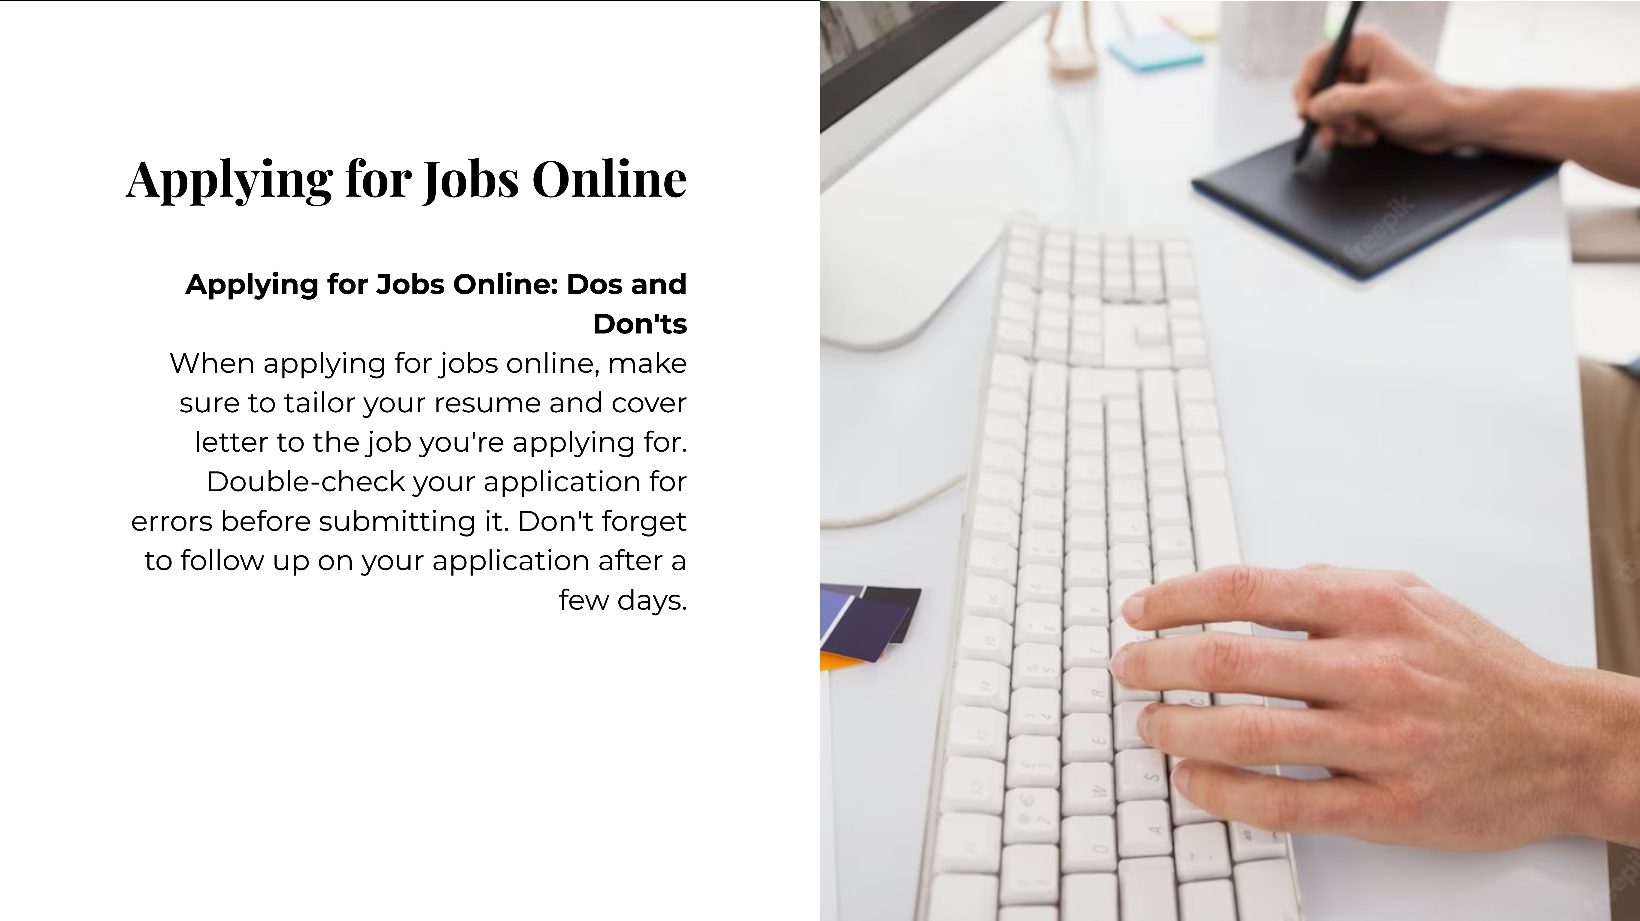

Slide 9
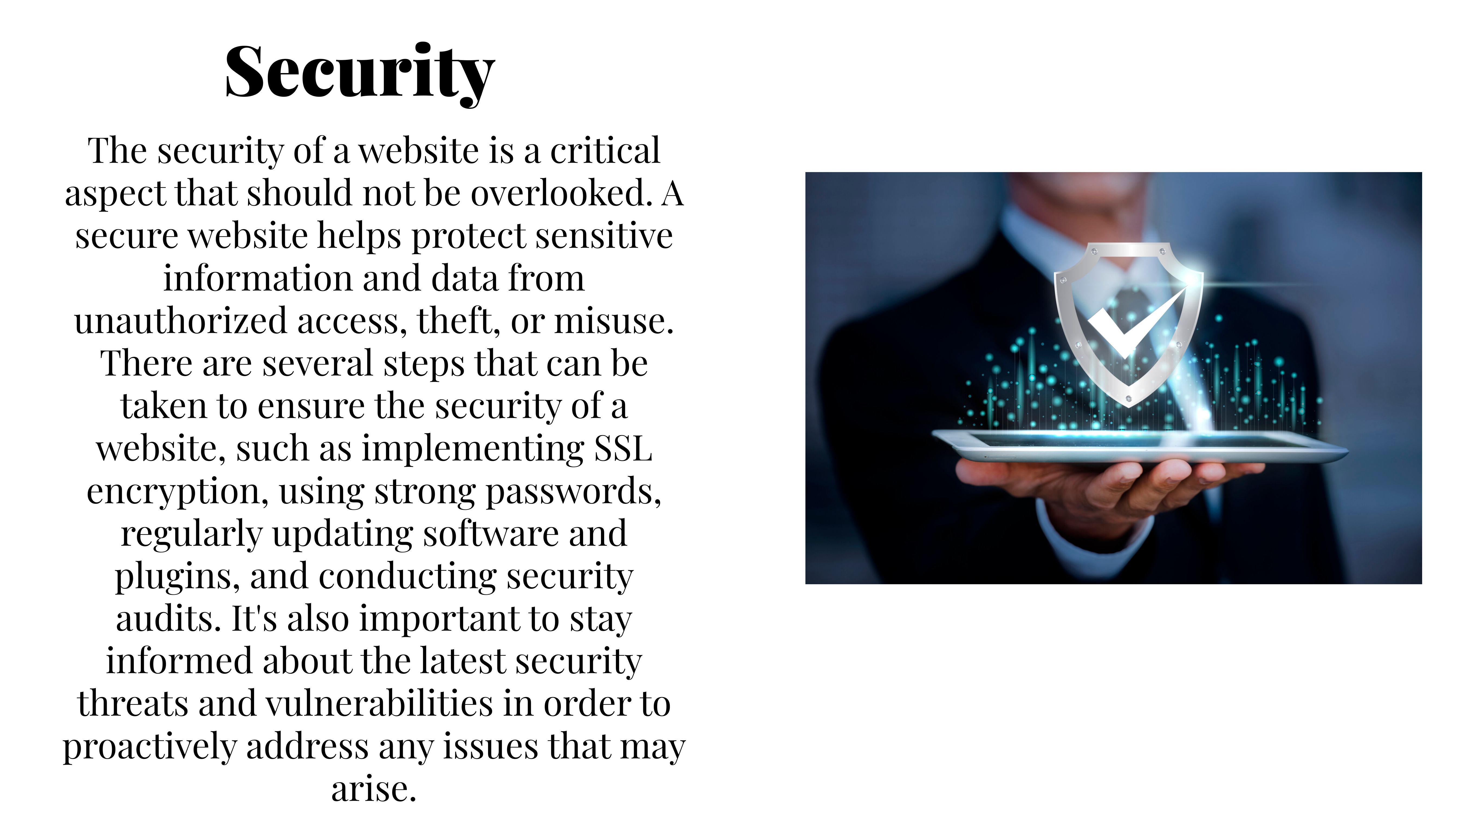

Slide 10


Slide 11
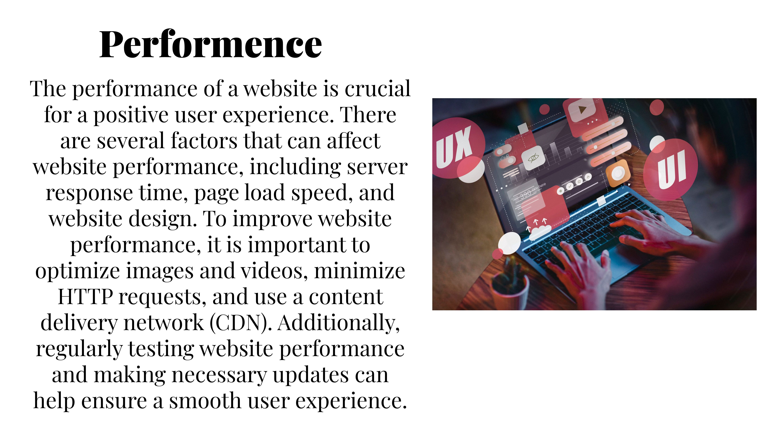

Slide 12


Slide 13

Technology used:
HTML: HTML (Hypertext Markup Language) is a standard markup language used for creating the structure and content of web pages. It forms the foundation of the World Wide Web and is essential for building websites and web applications.
CSS: CSS (Cascading Style Sheets) can be used in conjunction with HTML to control the presentation and layout of web pages. By using CSS, you can specify colors, fonts, spacing, and other visual properties, separate from the HTML structure.

Slide 14
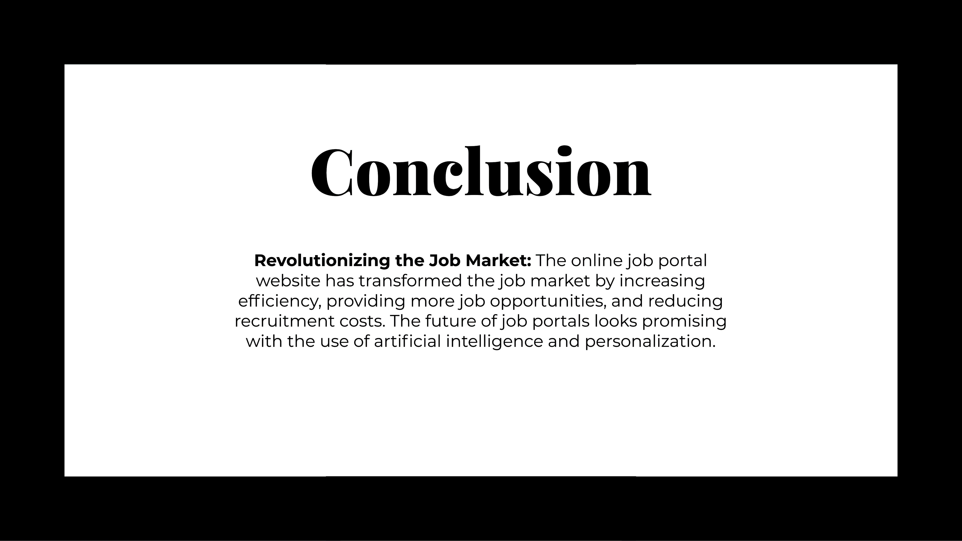

Slide 15
References:
www.w3schools.com
www.codeacademy.com
www.learn-HTML.org
www.javatpoint.com

Slide 16


